Slide 1
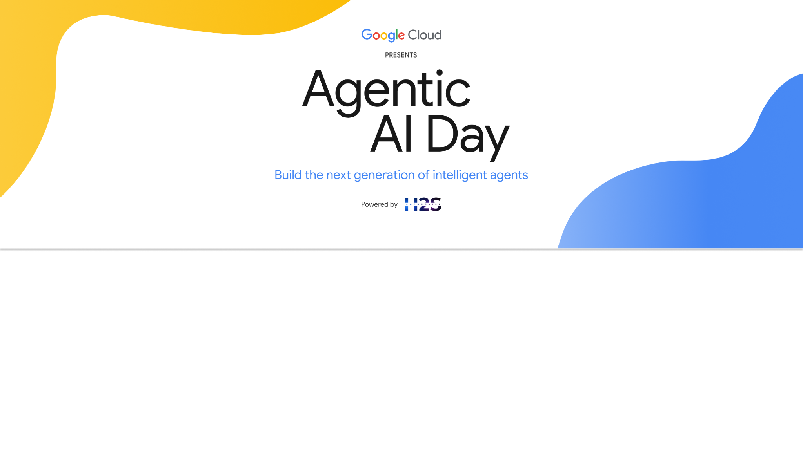
Team Details
Team name: ஆசிரியர் (Aasiriyar AI Team)
Team leader name: Soundararajan Arunachalam
Problem statement: Empowering Teachers in Multi-Grade Classrooms

Slide 2
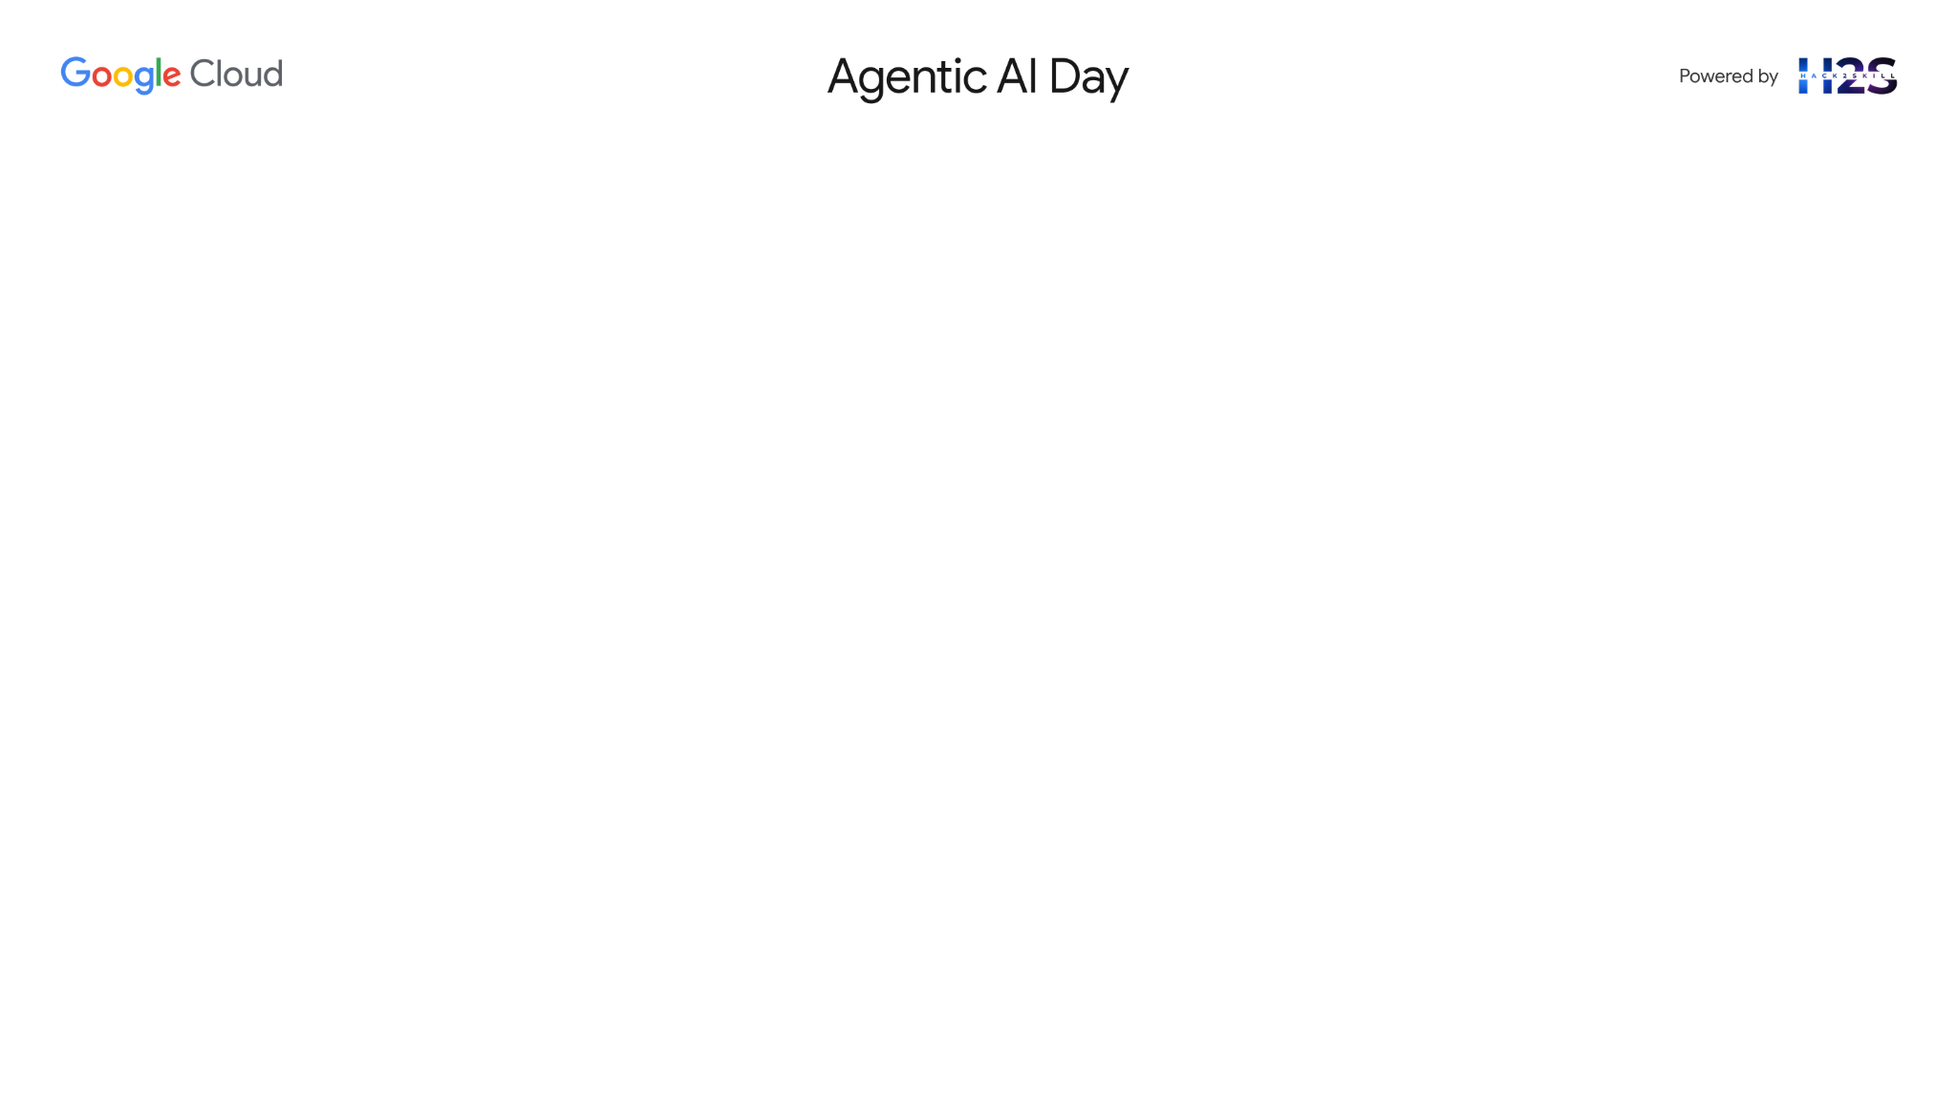
Brief about the idea
Sahayak: AI Teaching Assistant
Being a teacher or working in education can be super rewarding, but let's face it, the workload,
especially all the prep work, can be challenging! Plus, there's often not enough staff and tutoring
can be expensive. That's why we're proposing an AI-powered teaching assistant Sahayak.
What Sahayak Does
✓ Simplifies Prep Work – Auto-generates lesson plans, quizzes, worksheets
✓ Supports Local Languages – Handles regional input via Gemini
✓ Creates Interactive Content – Visuals, games, and learning materials
✓ Adds Audio Power – Audio materials and speech-driven responses
Built With
Google technologies: ADK, Vertex AI, Gemini API, Firebase Studio.
Impact
Empowers teachers, enables personalized learning, and brings AI into classrooms that need it most.

Slide 3
Opportunities
How different is it from existing solutions?
Hyper-localization: Unlike generic EdTech platforms, Sahayak generates content in regional languages with culturally relevant examples and contexts specific to rural and semi-urban India.
Most edtech platforms focus on student-facing tools or generic content delivery, this is teacher-based tool.
Low-tech compatibility: Works with minimal technology (can export to printable formats, create blackboard-friendly visuals) unlike solutions requiring 1:1 devices.
Multimodal input/output: Accepts voice, text, or images as input and generates diverse output formats suitable for varied teaching contexts.
How it solves the problem
Reduces preparation time: Automates the creation of lesson plans, worksheets, and visual aids that would normally take hours.
Enables differentiation: Instantly creates variations of the same material at different complexity levels for different grades.
Bridges resource gaps: Provides access to high-quality teaching materials even in schools with limited resources.
Supports local language: Functions in local languages, enabling teachers to provide instruction in students' mother tongues.

Slide 4
Opportunities
USP of the proposed solution
Designed for the multi-grade classroom reality of rural India rather than imposing Western single-grade classroom models.
Works within existing constraints (limited connectivity, minimal technology, vernacular medium) rather than requiring significant infrastructure upgrades.
Culturally contextual content generation that reflects local communities, traditions, and references.
Adaptable to varying levels of teacher tech proficiency with simple, intuitive interfaces.

Slide 5
List of features offered by the solution
📚
Course material
Generation
Lesson Planner
Assessment Builder
Worksheet Creator
🌐
Multilingual
interactive learning
Blackboard-Friendly Diagrams
Chart Generator
Concept Visualization
Game Builder (Activity ,Quiz)
🧑‍🏫
Teacher & Students Support Tools
GUI
Speech-to-Text Q&A
Resource Library
Export Options (print/share-friendly)

Slide 6
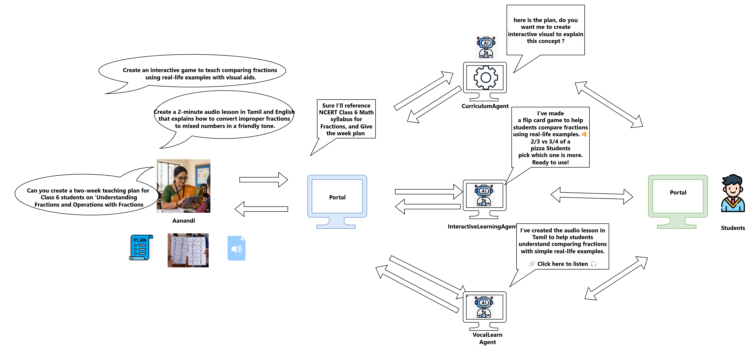
Process flow diagram or use-case diagram

Slide 7
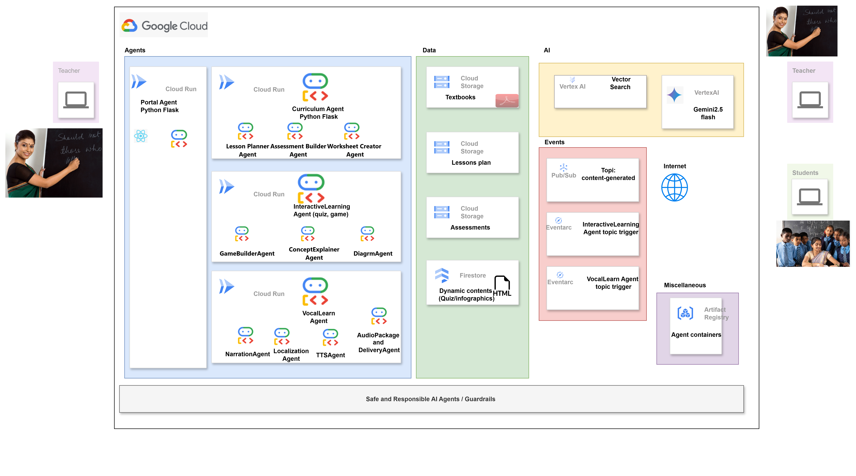
Architecture diagram of the proposed solution

Slide 8
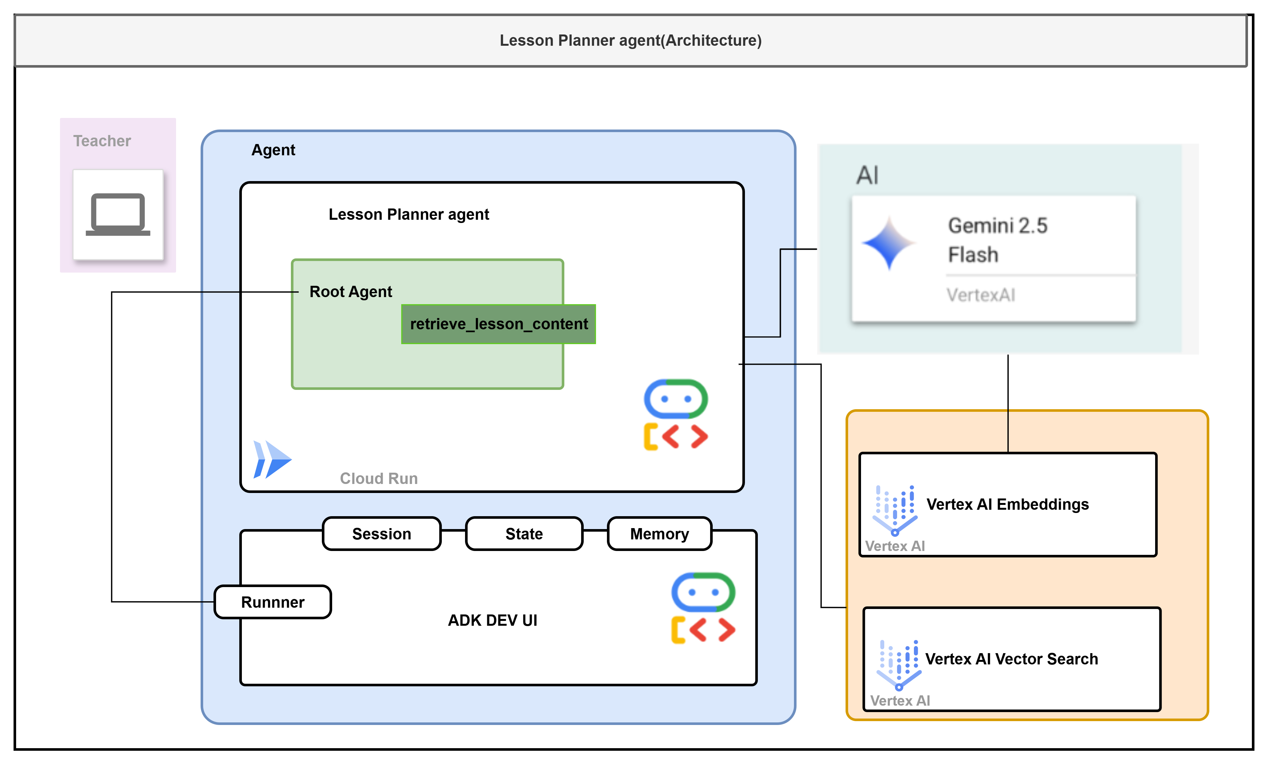
Basic Agent detailed view with ADK WEB
Teacher submits a request via Runner UI.
Runner sets up session, state, and memory.
Root Agent receives and handles the request.
Agent calls retrieve_lesson_content.
Query is embedded using Vertex AI.
Vector Search fetches relevant content.
Gemini Flash generates lesson plan.
Plan is sent back to the teacher.

Slide 9
Technologies to be used in the solution
Google Cloud Platform (GCP): Central to the entire system:
Vertex AI: Google's powerful Gemini 2.5 flash(multi model) LLM for various AI tasks alongside vector search capabilities.
Cloud Run: Serverless platform for deploying containerized agents and functions.
Pub/Sub & Eventarc: to enable event-driven architecture, enabling asynchronous communication between components.
Cloud Storage: Stores PDF , audio recaps and assignment files.
Firestore – to handle dynamic(HTML / Json ) data hosting
Artifact Registry: Stores Docker images for the agents.
Google's Gemini models (Gemini 2.5 flash): The core large language model responsible for intelligent tasks
like lesson planning, content creation, dynamic HTML generation, quiz explanations, and assignment consolidation.
Google ADK(agent development kit) : Frameworks for Agent LLM Application Development
Facilitates the creation of complex multi-agent workflows. Enables the intelligent orchestration of tools
(API calls, external tools, web searches).
Implements event-driven architecture for system scalability and flexibility.
In essence, our architecture combines the power of LLMs with structured data and event-driven communication,
all running on Google Cloud. This lets us build a scalable, reliable, and effective teaching assistant.

Slide 10
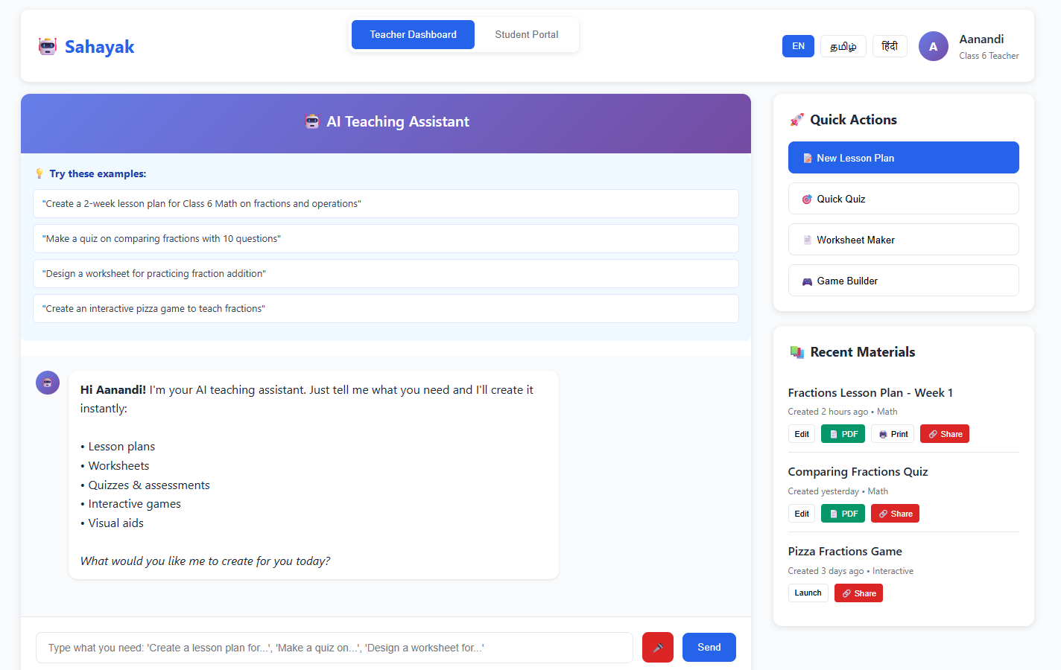
Wireframes/Mock diagrams of the proposed solution (optional)

Slide 11
